Slide 1
ERP
SYSTEM
BY WIZARDS

Slide 2
ERP SYSTEM INTRODUCTION
Cloud based Erp system to manage organization specifically Colleges and Universities .
College Management System is an end-to-end solution for colleges to improve operational efficiency & institutional outcomes by automating Student-Faculty lifecycle & campus administration. This college ERP software is designed keeping in mind the different operations of a college.

Slide 3
ERP SYSTEM
01
02
03
04
05
06
ADMISSION MANAGEMENT
PAYROLL MANAGEMENT
STUDENT RECORDS
HRMS
LIBRARY MANAGEMENT
Assessment management

Slide 4
FEATURES
·The system will be used by four levels, which are Admin, Teacher, Librarian and Student.
·Admin can login using valid credentials and perform various task such as Adding a Teacher, Student and Librarian and also can view them.
·Admin can also add Time Table and Event details. System allows admin to view book request received from librarian.
·Teacher can login and perform various task such as add assignment, mark attendance, upload result and view event.

Slide 5
FEATURES
Librarian can login and perform task such as adding a single or multiple books, view added books, request a book, issue a book to students, return issued book from student and view event.
·Student can access the system by providing valid credentials access modules such as viewing their own profile, view books, view time-table, assignments, result, attendance and event.
·Super admin is the root node who adds the colleges into the system with their details. Also can view/delete a college from the system.
·Proposed system is easy to understand and user friendly too.
·In that system admin who handle the data.
·Admin can take information regarding fee detail.

Slide 6
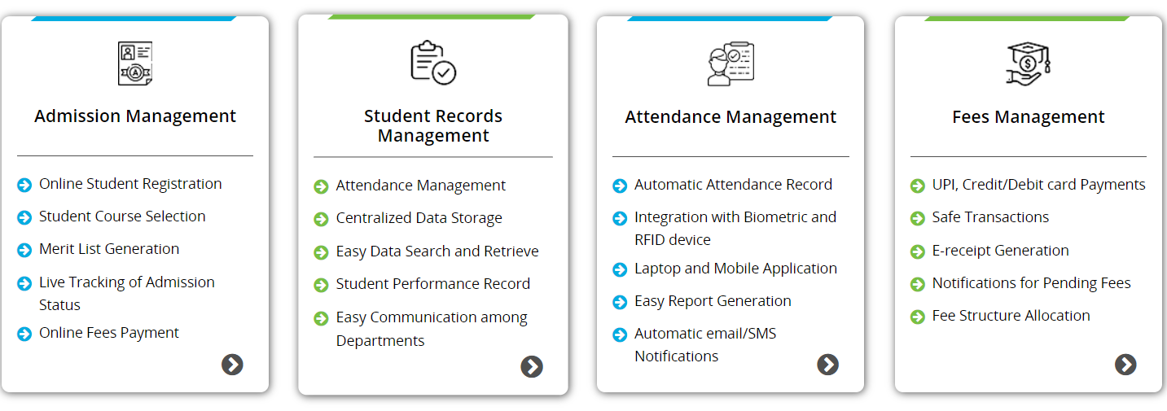
Modules of College ERP System
1
2
3
4

Slide 7
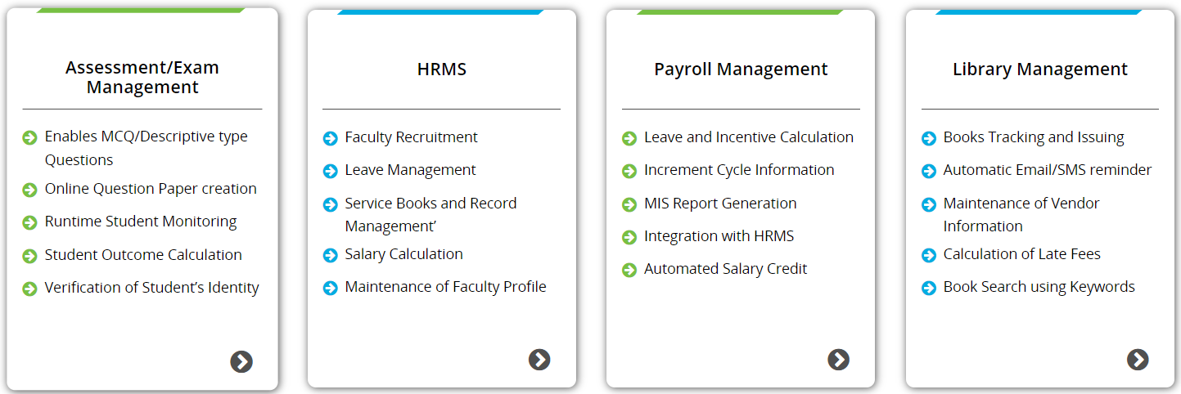
Modules of College ERP System
1
2
3
4

Slide 8
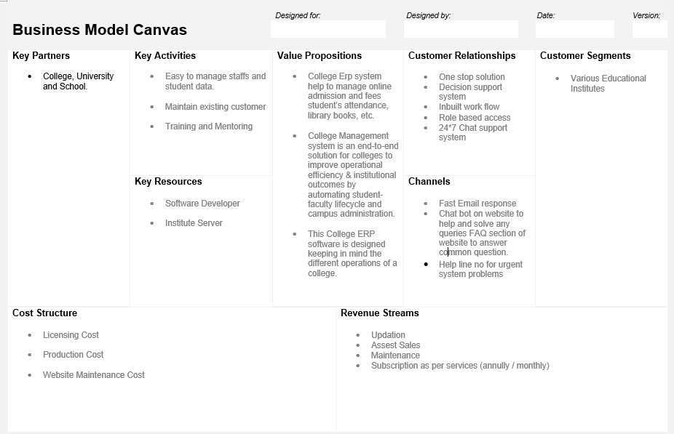
BUSINESS MODEL

Slide 9
Thanks
Team Wizards

